Slide 1
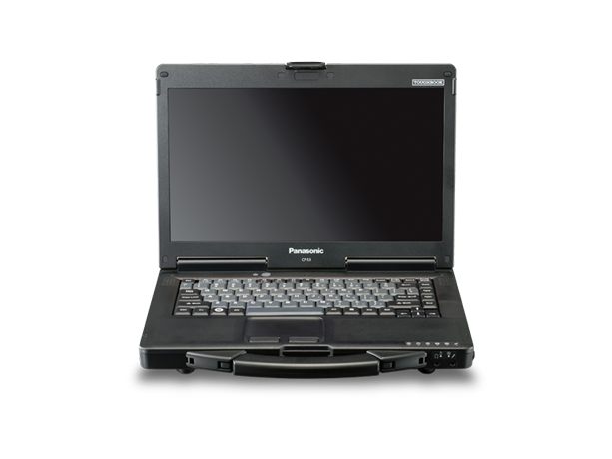
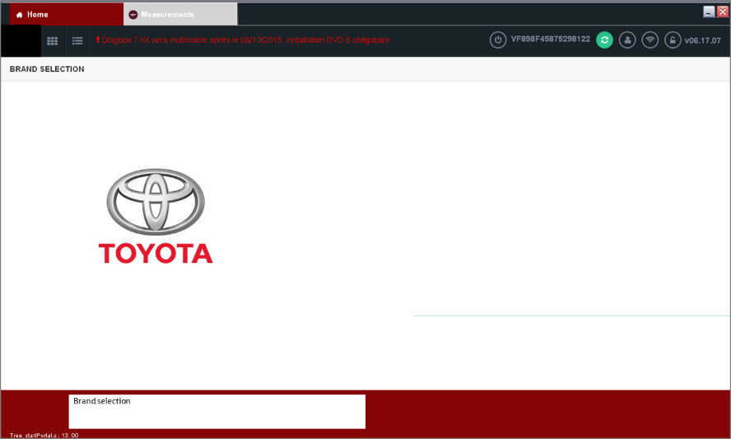
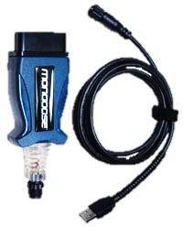
DiagBox for Toyota- Diagnostic tool support
Notes:
DiagBox on GTS

Slide 2
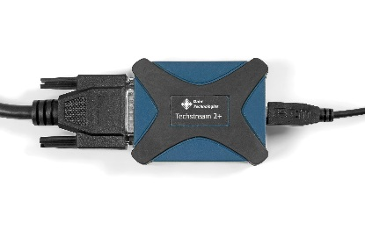
Background information:
For ProAce project TME has decided to adopt PSA’s diagnostic software that will run on Toyota’s specific PC hardware and vehicule interface.
PSA Server
300 active users
3.000 registred users
Toyota technicians will have same diagnostic capabilities as PSA technicians, including the connected services

Slide 3
Diagnostic tool support-> Current situation
PSA Serav
Online automatic configuration
Online ECU reflash software distribution
User authentification for secured operations
Dedicated email templates for assistance request will be used between all actors. All information requested will be joint in order for the request to become active!
PSA level 2 support
PSA diagbox support maibox
NMSC level 1 support
TME level 2 support
Technician will manually retrieve the mandatory trace file, provide event explanation and printscreens
TME as PSA level 1 support
Mail at:
Diagbox_Support@toyota-europe.com

Slide 4
Rules
For better assistance, between TME and PSA , the following 4 email templates have been created.
NMSC support will have to use this format when elevating problems towards Diagbox_Support@toyota-europe.com and make sure all required information are attached
Email template selection based on the nature of the incident :
• Template« Assistance Diagnostic Tools TME ACTIVATION » for incident Activation Diagbox
• Template« Assistance Diagnostic Tools TME COMREPA » for incident Configuration manual, learning process, actuator tests, measure parameters, Identification, PVN…
• Template« Assistance Diagnostic Tools TME MAINTENANCE LAPTOP PSA » for incident Computeur Hardware
• Template« Assistance Diagnostic Tools TME TELEXX » for incident configuration automatic and download

Slide 5
Email templates
available here

Slide 6
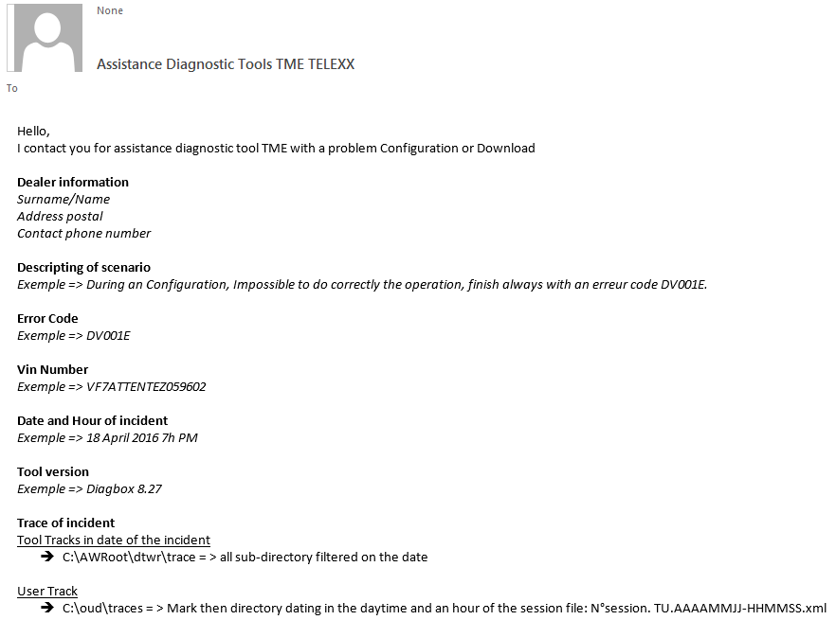
<-User info
<-Context
<-Event ident.
<-Raw comm.

